Slide 1
Traffic Light Controller For Emergency Vehicle Identification Based On Computer Vision And Acoustic Signals
Team Members:
1. Celsi Jaya Sreejha P - 811721104020
2. Charubala A - 811721104021
3. Christina Emy G - 811721104023
4. Jesira Banu M - 811721104040 Guided By:
Mr.M.Saravanan.M.E.,

Slide 2
Content
Abstract
Problem Statement
Existing System
Literature Survey
Proposed System
Architecture
Modules
Module Outputs

Slide 3
ABSTRACT
Congestion at traffic light area gives challenge in many countries. The increasing numbers of vehicles not only has a large environmental impact, but also result in loss of lives and time on the road.
Besides, there will be huge losses in terms of productivity where it will affect the ability of cities to compete globally.
This situation demands a better approach to handle the situation especially for emergency vehicle like ambulance.
There is a need to have a system that can control the traffic light signal at junction in case of emergency.

Slide 4
PROBLEM STATEMENT
Emergency response times are critical, but current traffic light systems fail to prioritize emergency vehicles like ambulances efficiently due to outdated fixed-timing algorithms and lack of coordination.
This delay in response time can cost lives, especially in urban environments with heavy traffic. Additionally, there is a pressing need for advanced systems to detect and recognize emergency vehicles in real time for better traffic management.

Slide 5
EXISTING SYSTEM
Some traffic light systems may include sensors such as loop detectors to detect the presence of vehicles or pedestrians at the intersection.
In some cases, traffic light timings may be manually adjusted by traffic engineers or technicians based on historical traffic patterns or special events.
The existing system may lack coordination between adjacent intersections, leading to inefficiencies such as traffic congestion, long wait times, and unnecessary delays.

Slide 6
LITERATURE SURVEY
Sl.No | Paper Title | Year of Publish | Techniques Used | Merits | Demerits
1 | IoT-Based Emergency Vehicle Services in Intelligent Transportation System | 2023 | Optimized routing algorithm | Real-Time Monitoring and Decision-Making | High Implementation Cost
2 | V2X-Based Highly Reliable Warning System for Emergency Vehicles | 2023 | Fastest path algorithm | Faster Emergency Response Time | Sensor and Hardware Reliability Issues
3 | Acoustic Based Emergency Vehicle Detection Using Ensemble of deep Learning Model | 2023 | Fully connected (FCNet) | Reduces false positives and false negatives | Computational Complexity and Latency
4 | LibSignal: An Open Library for Traffic Signal Control | 2023 | LibSignal Toolkit | Scalable for Different Traffic Environments | Complex Deployment and Maintenance
5 | Intelligent Road Management System for Autonomous, Non-Autonomous, and VIP Vehicles | 2023 | Conditional optimization | Efficient Traffic Flow Management | Support images only

Slide 7
LITERATURE SURVEY
Sl.No | Paper Title | Year of Publish | Techniques Used | Merits | Demerits
6 | Traffic signal optimization on a square lattice with quantum annealing | 2021 | Conventional local control method | Enhanced Traffic Flow Efficiency | Only support the simulation environments
7 | Planning and Decision-making for Connected Autonomous Vehicles at Road Intersections: A Review | 2021 | Graph-based approach, prediction base approach, optimization-based approach a | Adaptive Traffic Management | Comparative analysis can be done
8 | Hierarchical trac light-aware routing via fuzzy reinforcement learning in software-defined vehicular networks | 2021 | Fuzzy reinforcement learning | Optimized Traffic Flow | Cost of Implementation is high

Slide 8
PROPOSED SYSTEM
Developing a traffic light controller for ambulances using YOLO v11 and algorithm based on image and sound input involves several critical steps
In this project we can implement deep learning algorithm named as convolutional neural network algorithm to extract the features from user input
To classify the vehicle image and sound to predict the ambulance
Optimize the traffic light from red to green signal

Slide 9
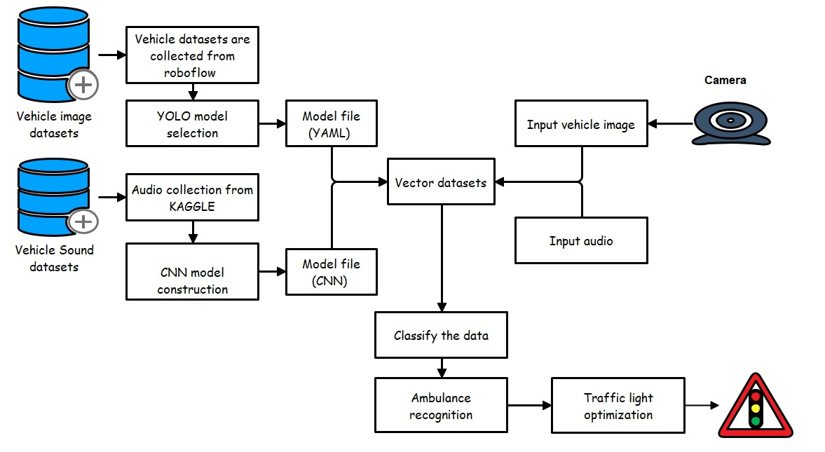
ARCHITECTURE DIAGRAM

Slide 10
MODULES
Input Module
Preprocessing Module
Computer Vision & Acoustic Signal Processing Module
Emergency Vehicle Detection & Classification Module
Traffic Light Control & Decision-Making Module
User Interface (UI) Module
Database & Storage Module
Report Generation & System Monitoring Module

Slide 11
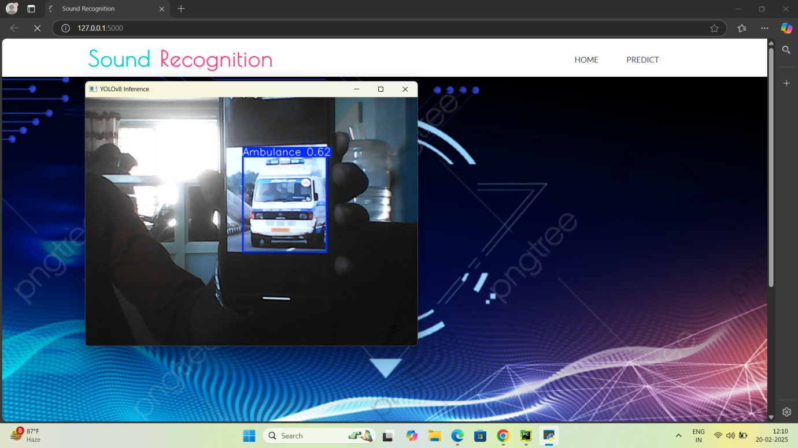
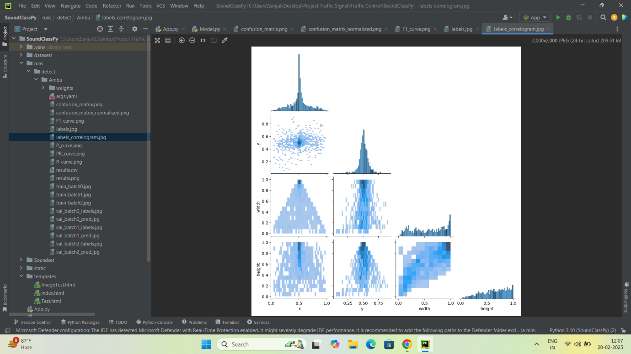
Modules Output

Slide 12
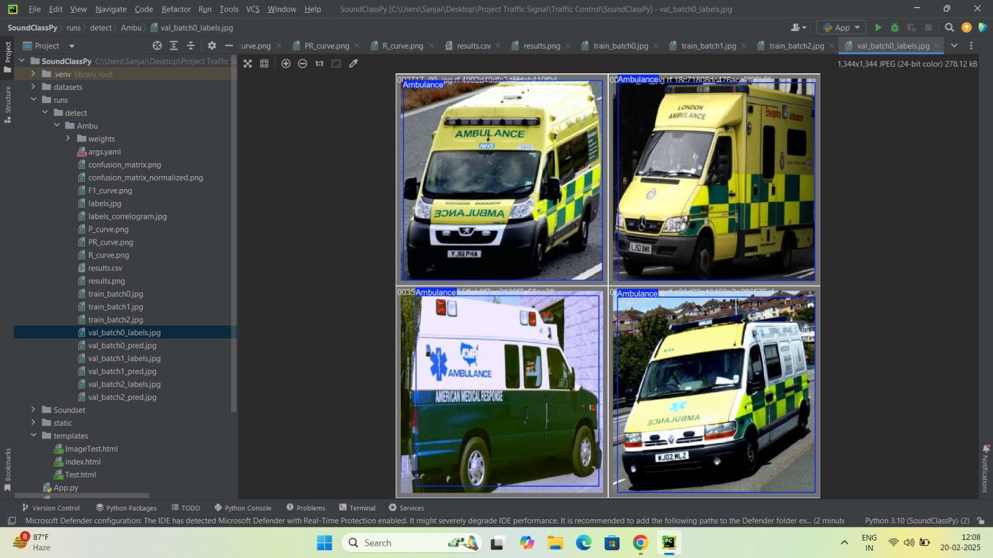
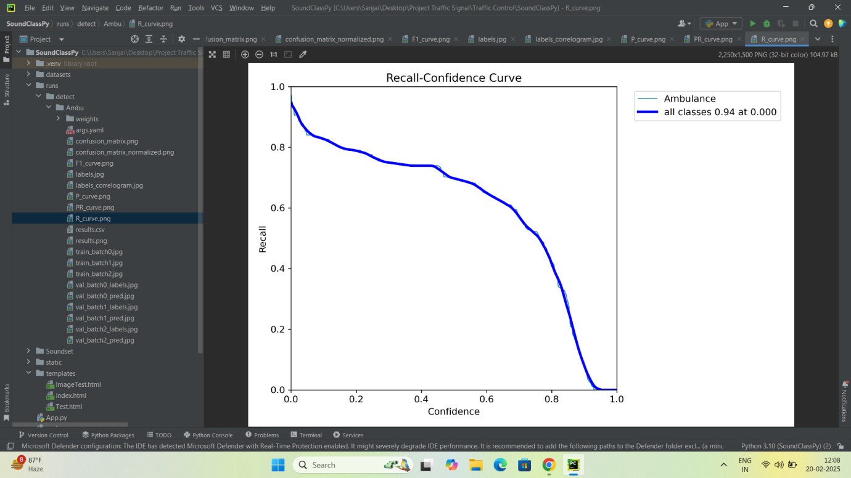
Modules Output

Slide 13
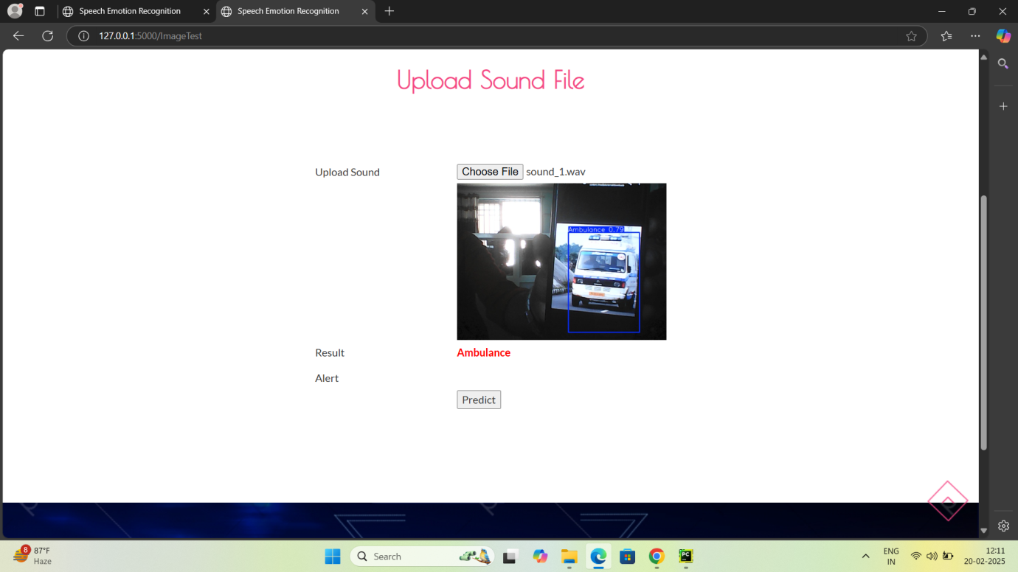
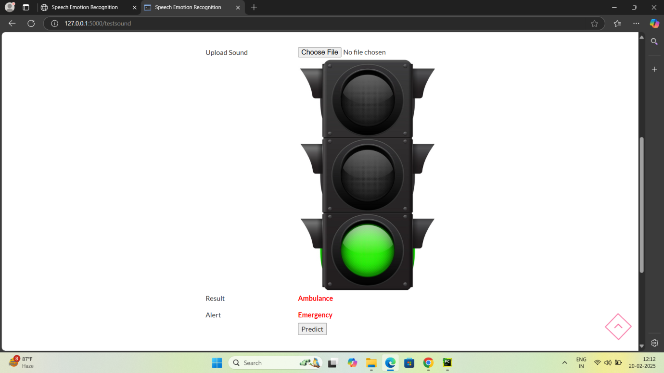
Modules Output

